Slide 1
UNIT IV
Classification: Basic Concepts and Techniques
T.SudhaRani,Assoc.Professor DWDM

Slide 2
Classification: Definition
Given a collection of records (training set )
  Each record is by characterized by a tuple (x,y), where x is the attribute set and y is the class label
    x: attribute, predictor, independent variable, input
    y: class, response, dependent variable, output
Task:
  Learn a model that maps each attribute set x into one of the predefined class labels y
T.SudhaRani,Assoc.Professor DWDM

Slide 3
Examples of Classification Task
Task | Attribute set, x | Class label, y
Categorizing email messages | Features extracted from email message header and content | spam or non-spam
Identifying tumor cells | Features extracted from x-rays or MRI scans | malignant or benign cells
Cataloging galaxies | Features extracted from telescope images | Elliptical, spiral, or irregular-shaped galaxies
T.SudhaRani,Assoc.Professor DWDM

Slide 4
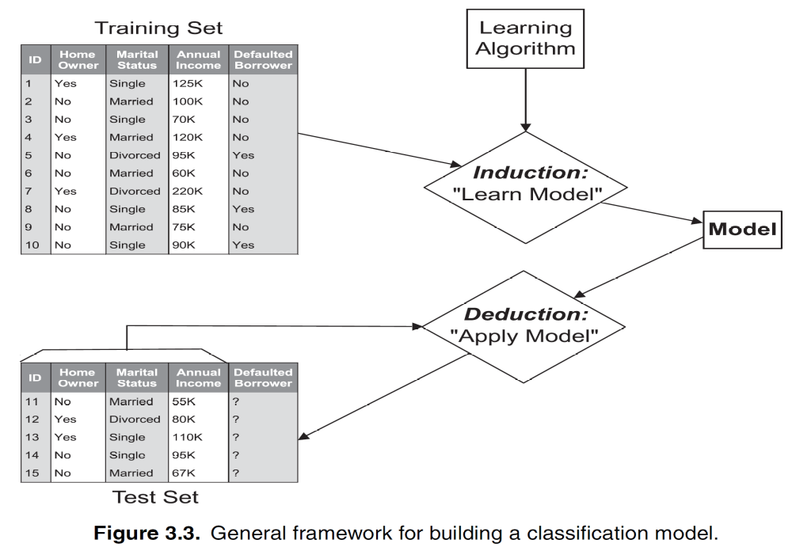
General Approach for Building Classification Model
T.SudhaRani,Assoc.Professor DWDM

Slide 5
Classification Techniques
Base Classifiers
  Decision Tree based Methods
  Rule-based Methods
  Nearest-neighbor
  Naïve Bayes and Bayesian Belief Networks
  Support Vector Machines
  Neural Networks, Deep Neural Nets
Ensemble Classifiers
  Boosting, Bagging, Random Forests
T.SudhaRani,Assoc.Professor DWDM

Slide 6
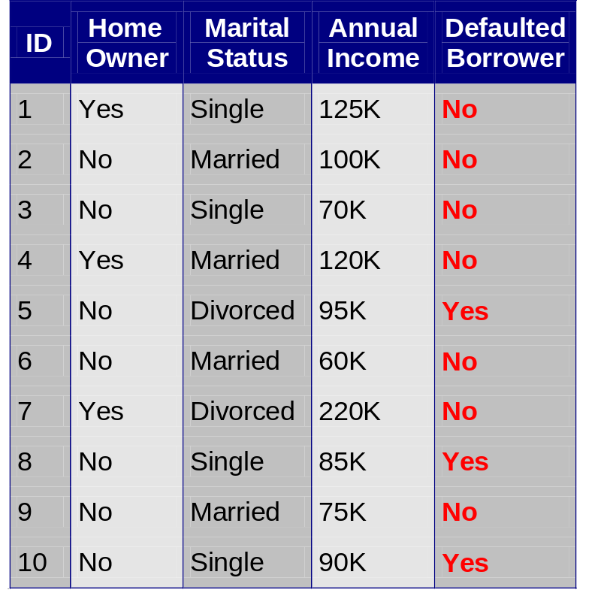
Example of a Decision Tree
categorical
categorical
continuous
class
Splitting Attributes
Home Owner
Yes
No
NO
MarSt
Single, Divorced
Married
Income
NO
< 80K
> 80K
NO
YES
Training Data
Model: Decision Tree
T.SudhaRani,Assoc.Professor DWDM

Slide 7
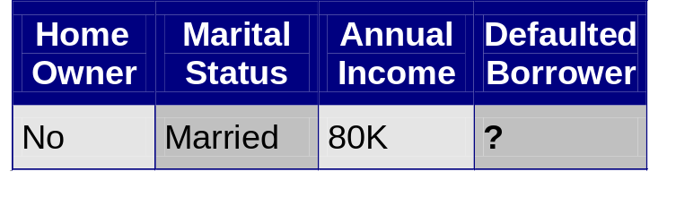
Apply Model to Test Data
Test Data
Start from the root of tree.
Home Owner
Yes
No
NO
MarSt
Single, Divorced
Married
Income
NO
< 80K
> 80K
NO
YES
T.SudhaRani,Assoc.Professor DWDM

Slide 8
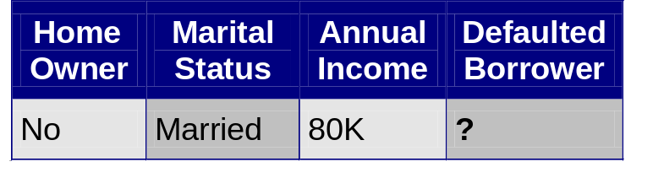
Apply Model to Test Data
Test Data
Home Owner
Yes
No
NO
MarSt
Single, Divorced
Married
Income
NO
< 80K
> 80K
NO
YES
T.SudhaRani,Assoc.Professor DWDM

Slide 9
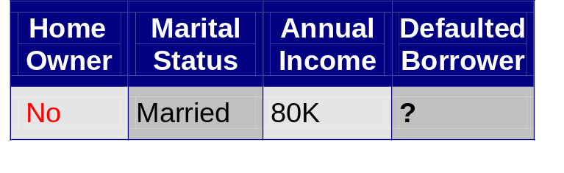
Apply Model to Test Data
Test Data
Home Owner
Yes
No
NO
MarSt
Single, Divorced
Married
Income
NO
< 80K
> 80K
NO
YES
T.SudhaRani,Assoc.Professor DWDM

Slide 10
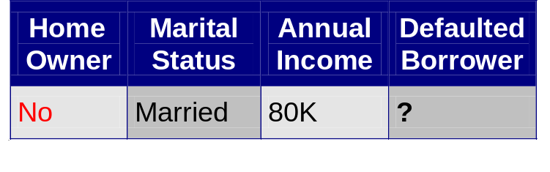
Apply Model to Test Data
Test Data
Home Owner
Yes
No
NO
MarSt
Single, Divorced
Married
Income
NO
< 80K
> 80K
NO
YES
T.SudhaRani,Assoc.Professor DWDM

Slide 11
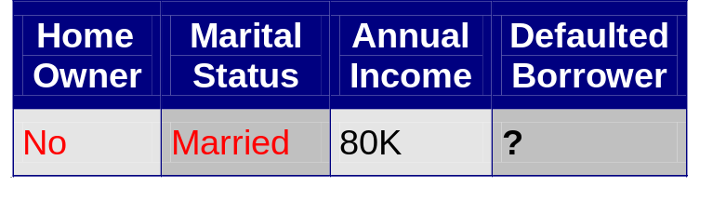
Apply Model to Test Data
Test Data
Home Owner
Yes
No
NO
MarSt
Single, Divorced
Married
Income
NO
< 80K
> 80K
NO
YES
T.SudhaRani,Assoc.Professor DWDM

Slide 12
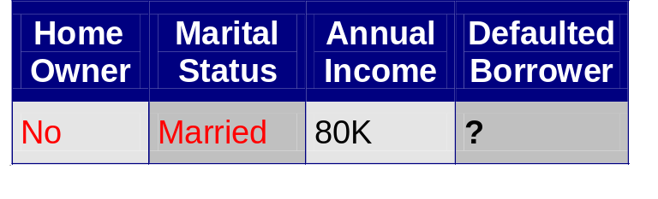
Apply Model to Test Data
Test Data
Home Owner
Yes
No
NO
MarSt
Single, Divorced
Married
Assign Defaulted to “No”
Income
NO
< 80K
> 80K
NO
YES
T.SudhaRani,Assoc.Professor DWDM

Slide 13
Another Example of Decision Tree
categorical
categorical
continuous
class
Single, Divorced
MarSt
Married
NO
Home Owner
Yes
No
NO
Income
< 80K
> 80K
NO
YES
There could be more than one tree that fits the same data!
T.SudhaRani,Assoc.Professor DWDM

Slide 14

Decision Tree Classification Task
Decision Tree
T.SudhaRani,Assoc.Professor DWDM

Slide 15
Decision Tree Induction
Many Algorithms:
  Hunt’s Algorithm (one of the earliest)
  CART
  ID3, C4.5
  SLIQ,SPRINT
T.SudhaRani,Assoc.Professor DWDM

Slide 16
General Structure of Hunt’s Algorithm
Let D_{t} be the set of training records that reach a node t
General Procedure:
  If D_{t} contains records that belong the same class y_{t}, then t is a leaf node labeled as y_{t}
  If D_{t} contains records that belong to more than one class, use an attribute test to split the data into smaller subsets. Recursively apply the procedure to each subset.
D_{t}
?
T.SudhaRani,Assoc.Professor DWDM

Slide 17
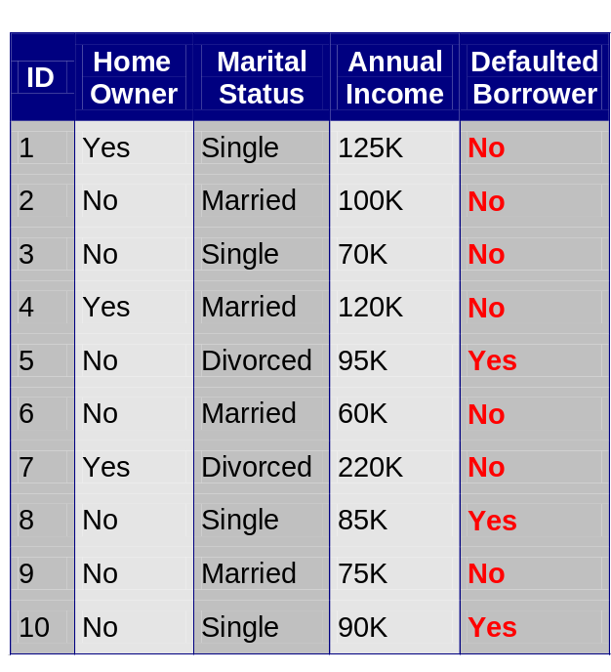
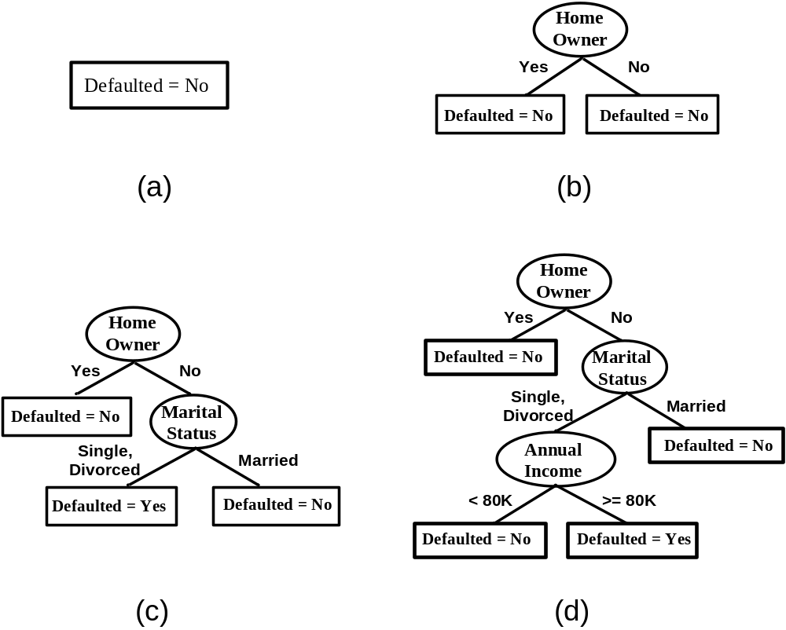
Hunt’s Algorithm
(7,3)
(3,0)
(4,3)
(3,0)
(3,0)
(3,0)
(1,3)
(3,0)
(1,0)
(0,3)
T.SudhaRani,Assoc.Professor DWDM

Slide 18
Hunt’s Algorithm
(7,3)
(3,0)
(4,3)
(3,0)
(3,0)
(3,0)
(1,3)
(3,0)
(1,0)
(0,3)
T.SudhaRani,Assoc.Professor DWDM

Slide 19
Hunt’s Algorithm
(7,3)
(3,0)
(4,3)
(3,0)
(3,0)
(3,0)
(1,3)
(3,0)
(1,0)
(0,3)
T.SudhaRani,Assoc.Professor DWDM

Slide 20
Hunt’s Algorithm
(7,3)
(3,0)
(4,3)
(3,0)
(3,0)
(3,0)
(1,3)
(3,0)
(1,0)
(0,3)
T.SudhaRani,Assoc.Professor DWDM

Slide 21
Design Issues of Decision Tree Induction
How should training records be split?
  Method for expressing test condition
    depending on attribute types
  Measure for evaluating the goodness of a test condition
How should the splitting procedure stop?
  Stop splitting if all the records belong to the same class or have identical attribute values
  Early termination
T.SudhaRani,Assoc.Professor DWDM

Slide 22
Methods for Expressing Test Conditions
Depends on attribute types
  Binary
  Nominal
  Ordinal
  Continuous
T.SudhaRani,Assoc.Professor DWDM

Slide 23
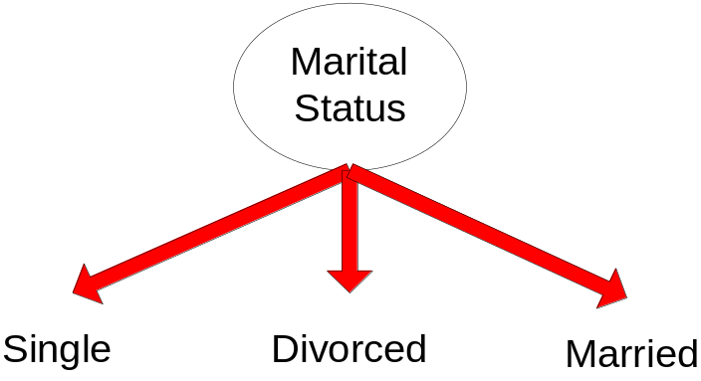
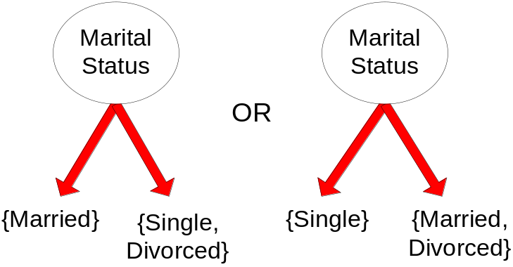
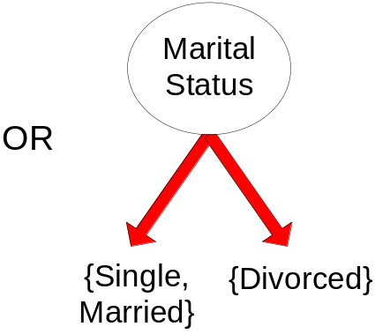
Test Condition for Nominal Attributes
Multi-way split:
  Use as many partitions as distinct values.
Binary split:
  Divides values into two subsets
T.SudhaRani,Assoc.Professor DWDM

Slide 24
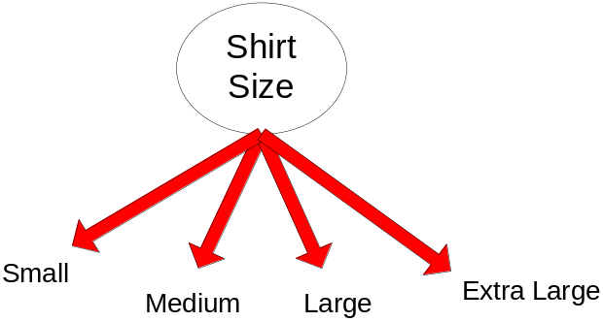
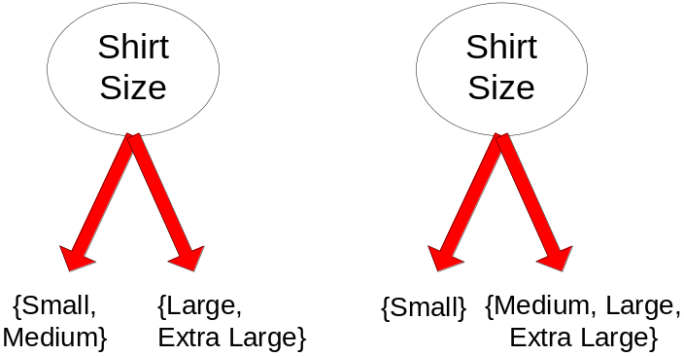
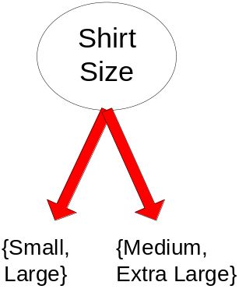
Test Condition for Ordinal Attributes
Multi-way split:
  Use as many partitions as distinct values
Binary split:
  Divides values into two subsets
  Preserve order property among attribute values
This grouping violates order property
T.SudhaRani,Assoc.Professor DWDM

Slide 25
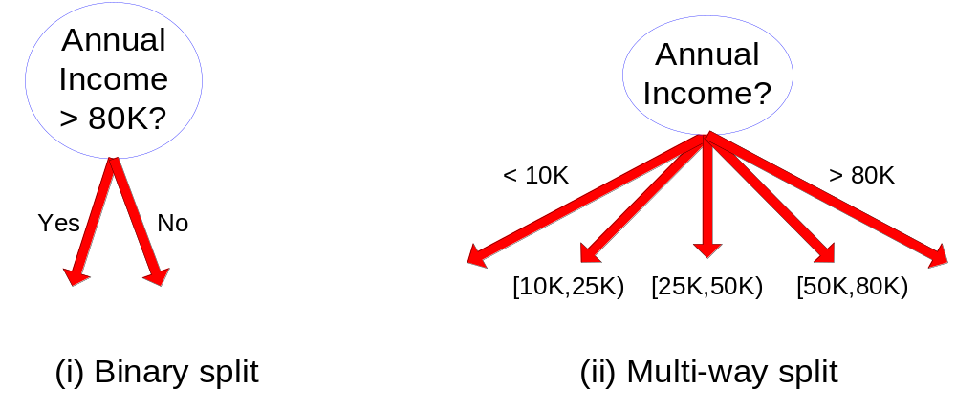
Test Condition for Continuous Attributes
T.SudhaRani,Assoc.Professor DWDM

Slide 26
Splitting Based on Continuous Attributes
Different ways of handling
  Discretization to form an ordinal categorical attribute
    Ranges can be found by equal interval bucketing, equal frequency bucketing (percentiles), or clustering.
    Static – discretize once at the beginning
    Dynamic – repeat at each node
  Binary Decision: (A < v) or (A ≥ v)
    consider all possible splits and finds the best cut
    can be more compute intensive
T.SudhaRani,Assoc.Professor DWDM

Slide 27
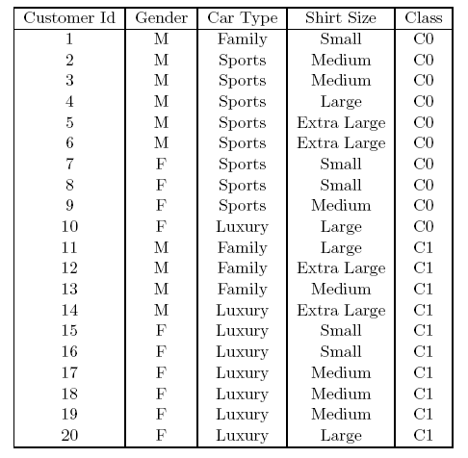
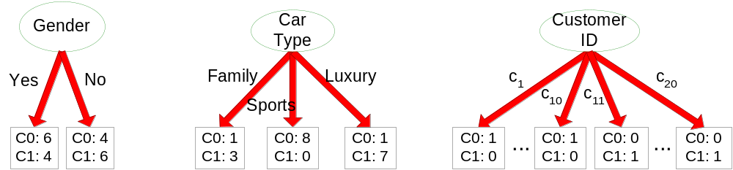
How to determine the Best Split
Before Splitting: 10 records of class 0,
10 records of class 1
Which test condition is the best?
T.SudhaRani,Assoc.Professor DWDM

Slide 28

How to determine the Best Split
These measures try to give preference to attribute test conditions that partition the training instances into purer subsets in the child nodes, which mostly have the same class labels.
Having purer nodes is useful since a node that has all of its training instances from the same class does not need to be expanded further.
In contrast, an impure node containing training instances from multiple classes is likely to require several levels of node expansions, thereby increasing the depth of the tree considerably
T.SudhaRani,Assoc.Professor DWDM

Slide 29
How to determine the Best Split
Impurity Measure for a Single Node:
The impurity of a node measures how dissimilar the class labels are for the datainstances belonging to a common node
T.SudhaRani,Assoc.Professor DWDM

Slide 30

How to determine the Best Split
Greedy approach:
  Nodes with purer class distribution are preferred
Need a measure of node impurity:
High degree of impurity
Low degree of impurity
T.SudhaRani,Assoc.Professor DWDM

Slide 31
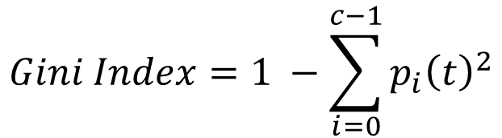
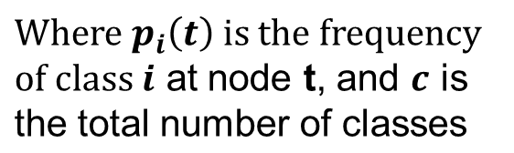
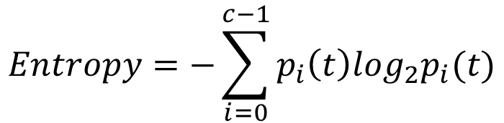
Measures of Node Impurity
Gini Index
Entropy
Misclassification error
T.SudhaRani,Assoc.Professor DWDM

Slide 32
Finding the Best Split
Compute impurity measure (P) before splitting
Compute impurity measure (M) after splitting
    Compute impurity measure of each child node
    M is the weighted impurity of child nodes
Choose the attribute test condition that produces the highest gain
    Gain = P - M
    or equivalently, lowest impurity measure after splitting (M)
T.SudhaRani,Assoc.Professor DWDM

Slide 33



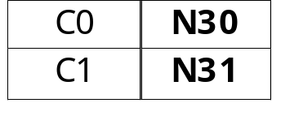

Finding the Best Split
Before Splitting:
P
A?
B?
Yes
No
Yes
No
Node N1
Node N2
Node N3
Node N4
M11
M12
M21
M22
M1
M2
Gain = P – M1 vs P – M2
T.SudhaRani,Assoc.Professor DWDM

Slide 34
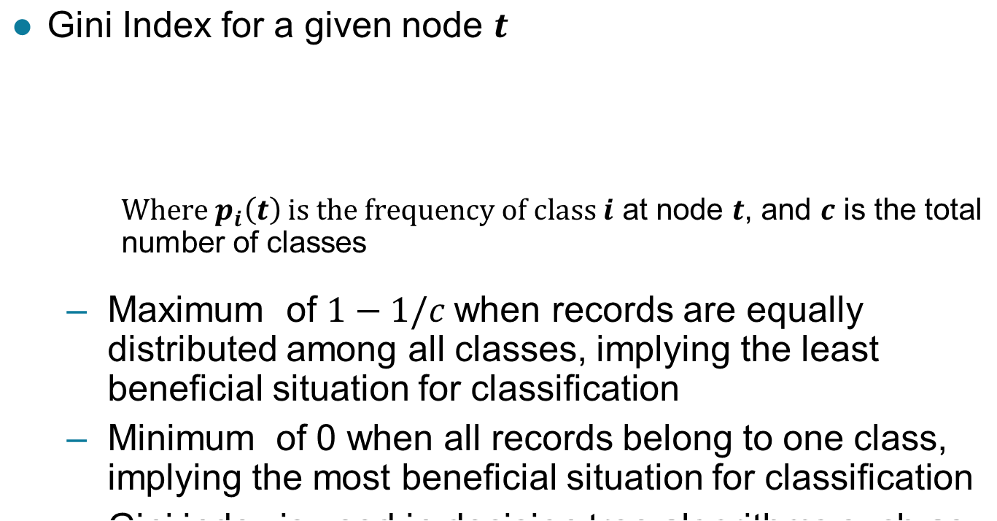
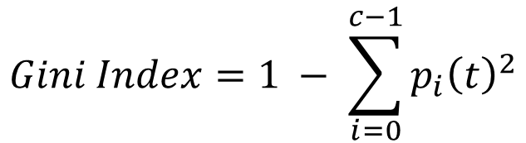
Measure of Impurity: GINI
T.SudhaRani,Assoc.Professor DWDM

Slide 35
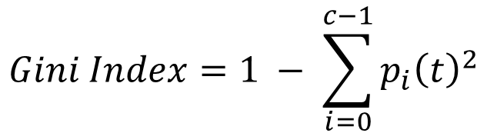




Measure of Impurity: GINI
Gini Index for a given node t :
  For 2-class problem (p, 1 – p):
    GINI = 1 – p² – (1 – p)² = 2p (1-p)
T.SudhaRani,Assoc.Professor DWDM

Slide 36
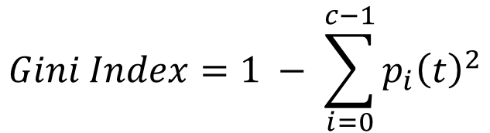



Computing Gini Index of a Single Node
P(C1) = 0/6 = 0 P(C2) = 6/6 = 1
Gini = 1 – P(C1)² – P(C2)² = 1 – 0 – 1 = 0
P(C1) = 1/6 P(C2) = 5/6
Gini = 1 – (1/6)² – (5/6)² = 0.278
P(C1) = 2/6 P(C2) = 4/6
Gini = 1 – (2/6)² – (4/6)² = 0.444
T.SudhaRani,Assoc.Professor DWDM

Slide 37
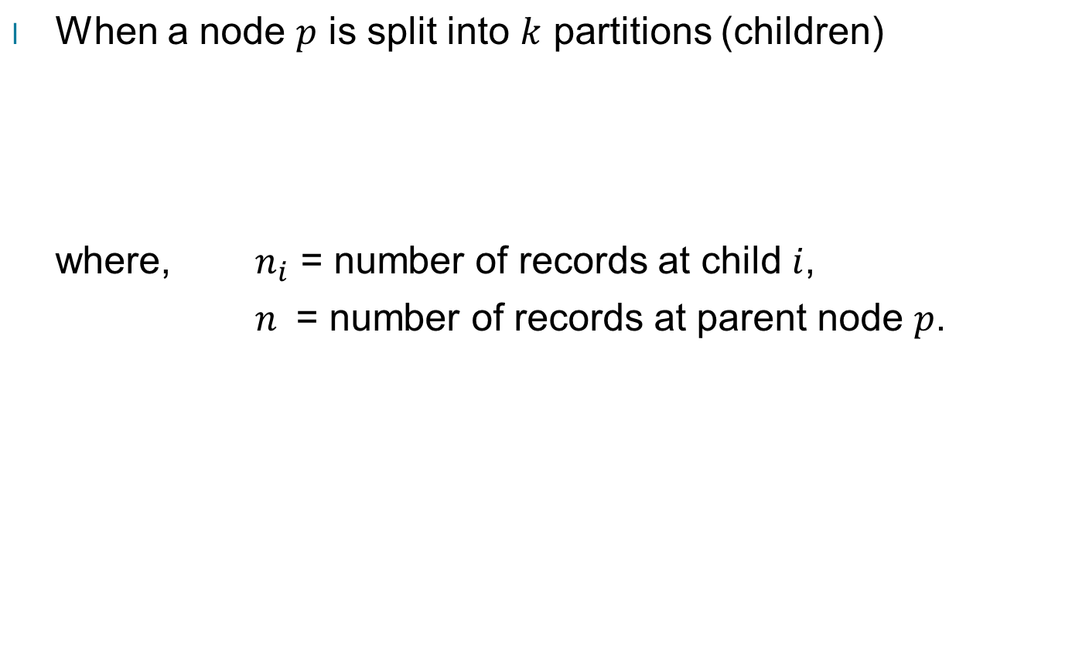
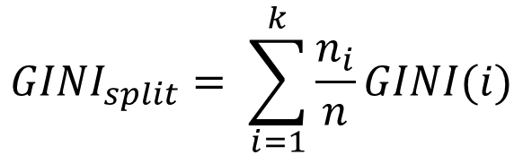
Computing Gini Index for a Collection of Nodes
T.SudhaRani,Assoc.Professor DWDM

Slide 38
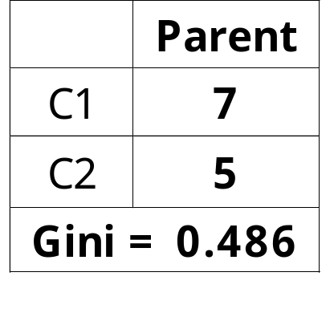
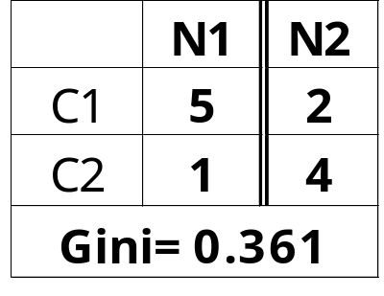
Binary Attributes: Computing GINI Index
Splits into two partitions (child nodes)
Effect of Weighing partitions:
  Larger and purer partitions are sought
B?
Yes
No
Node N1
Node N2
Gini(N1)
= 1 – (5/6)² – (1/6)²
= 0.278
Gini(N2)
= 1 – (2/6)² – (4/6)²
= 0.444
Weighted Gini of N1 N2
= 6/12 * 0.278 +
6/12 * 0.444
= 0.361
Gain = 0.486 – 0.361 = 0.125
T.SudhaRani,Assoc.Professor DWDM

Slide 39
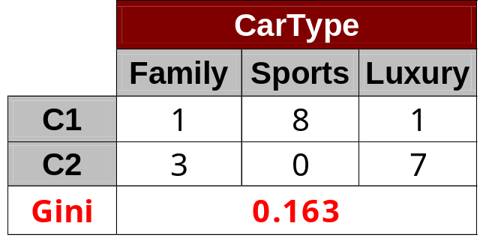
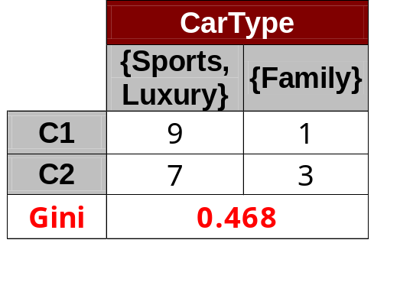
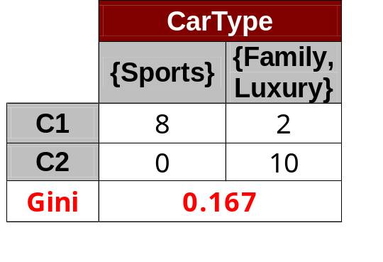
Categorical Attributes: Computing Gini Index
For each distinct value, gather counts for each class in the dataset
Use the count matrix to make decisions
Multi-way split
Two-way split
(find best partition of values)
Which of these is the best?
T.SudhaRani,Assoc.Professor DWDM

Slide 40
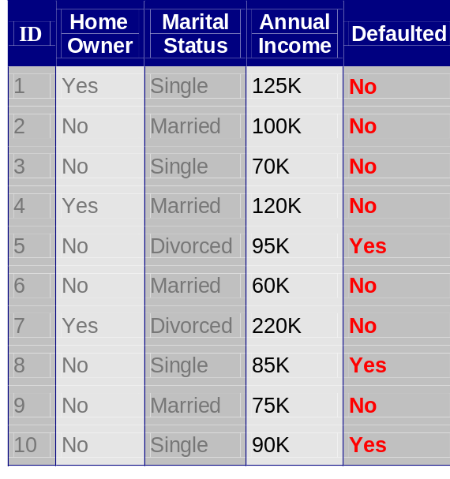
Continuous Attributes: Computing Gini Index
Use Binary Decisions based on one value
Several Choices for the splitting value
  Number of possible splitting values
  = Number of distinct values
Each splitting value has a count matrix associated with it
  Class counts in each of the partitions, A ≤ v and A > v
Simple method to choose best v
  For each v, scan the database to gather count matrix and compute its Gini index
  Computationally Inefficient! Repetition of work.
Annual Income ?
 | ≤ 80 | > 80
Defaulted Yes | 0 | 3
Defaulted No | 3 | 4
T.SudhaRani,Assoc.Professor DWDM

Slide 41
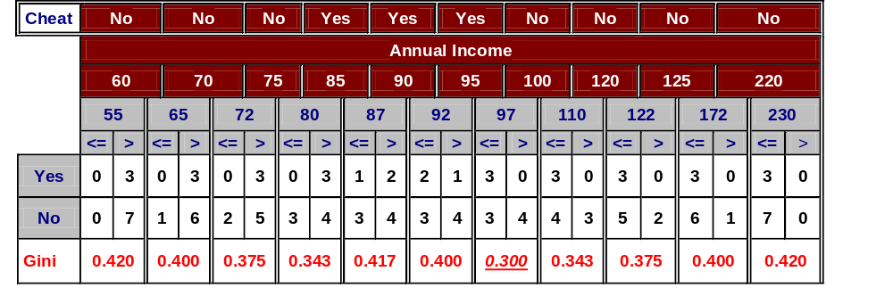
Continuous Attributes: Computing Gini Index...
For efficient computation: for each attribute,
  Sort the attribute on values
  Linearly scan these values, each time updating the count matrix and computing gini index
  Choose the split position that has the least gini index
Sorted Values
T.SudhaRani,Assoc.Professor DWDM

Slide 42
Continuous Attributes: Computing Gini Index...
For efficient computation: for each attribute,
  Sort the attribute on values
  Linearly scan these values, each time updating the count matrix and computing gini index
  Choose the split position that has the least gini index
Sorted Values
Split Positions
T.SudhaRani,Assoc.Professor DWDM

Slide 43
Continuous Attributes: Computing Gini Index...
For efficient computation: for each attribute,
  Sort the attribute on values
  Linearly scan these values, each time updating the count matrix and computing gini index
  Choose the split position that has the least gini index
Sorted Values
Split Positions
T.SudhaRani,Assoc.Professor DWDM

Slide 44
Continuous Attributes: Computing Gini Index...
For efficient computation: for each attribute,
  Sort the attribute on values
  Linearly scan these values, each time updating the count matrix and computing gini index
  Choose the split position that has the least gini index
Sorted Values
Split Positions
T.SudhaRani,Assoc.Professor DWDM

Slide 45
Continuous Attributes: Computing Gini Index...
For efficient computation: for each attribute,
  Sort the attribute on values
  Linearly scan these values, each time updating the count matrix and computing gini index
  Choose the split position that has the least gini index
Sorted Values
Split Positions
T.SudhaRani,Assoc.Professor DWDM

Slide 46
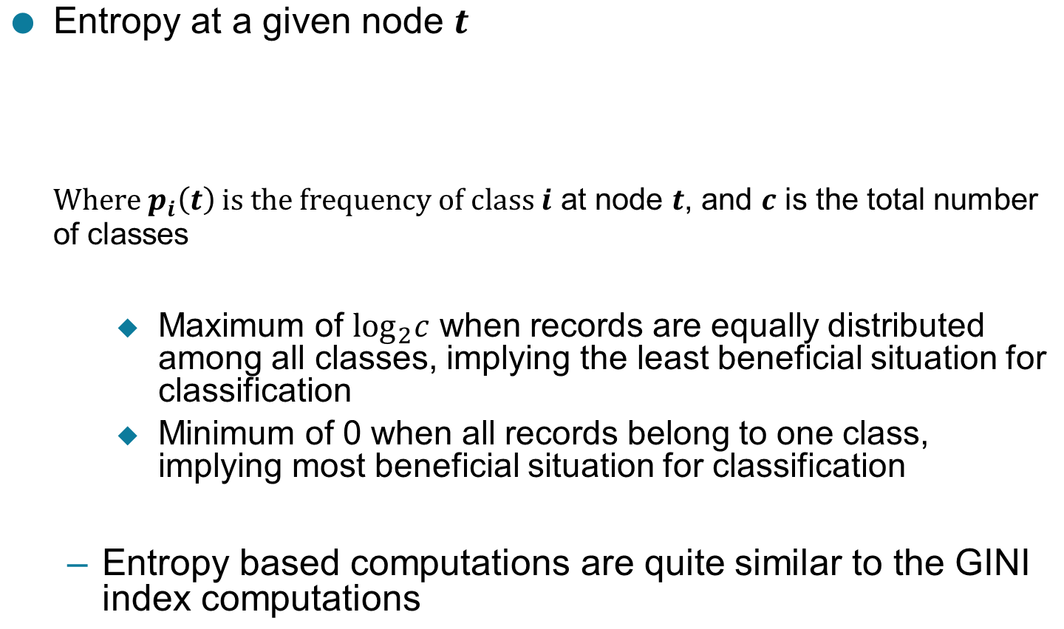
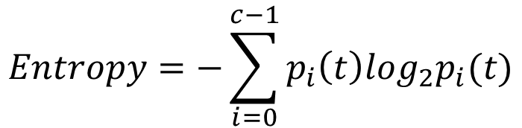
Measure of Impurity: Entropy
T.SudhaRani,Assoc.Professor DWDM

Slide 47
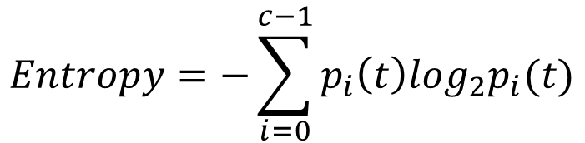
Computing Entropy of a Single Node
P(C1) = 0/6 = 0 P(C2) = 6/6 = 1
Entropy = – 0 log 0 – 1 log 1 = – 0 – 0 = 0
P(C1) = 1/6 P(C2) = 5/6
Entropy = – (1/6) log₂ (1/6) – (5/6) log₂ (1/6) = 0.65
P(C1) = 2/6 P(C2) = 4/6
Entropy = – (2/6) log₂ (2/6) – (4/6) log₂ (4/6) = 0.92
T.SudhaRani,Assoc.Professor DWDM

Slide 48
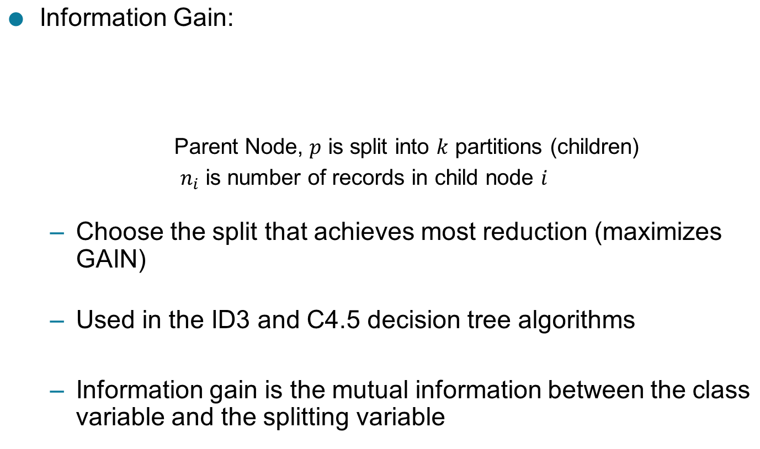
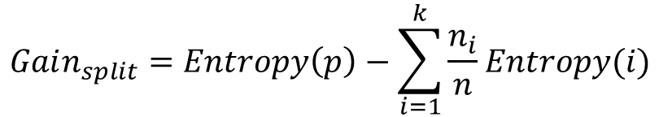
Computing Information Gain After Splitting
T.SudhaRani,Assoc.Professor DWDM

Slide 49
Problem with large number of partitions
Node impurity measures tend to prefer splits that result in large number of partitions, each being small but pure
  Customer ID has highest information gain because entropy for all the children is zero
T.SudhaRani,Assoc.Professor DWDM

Slide 50
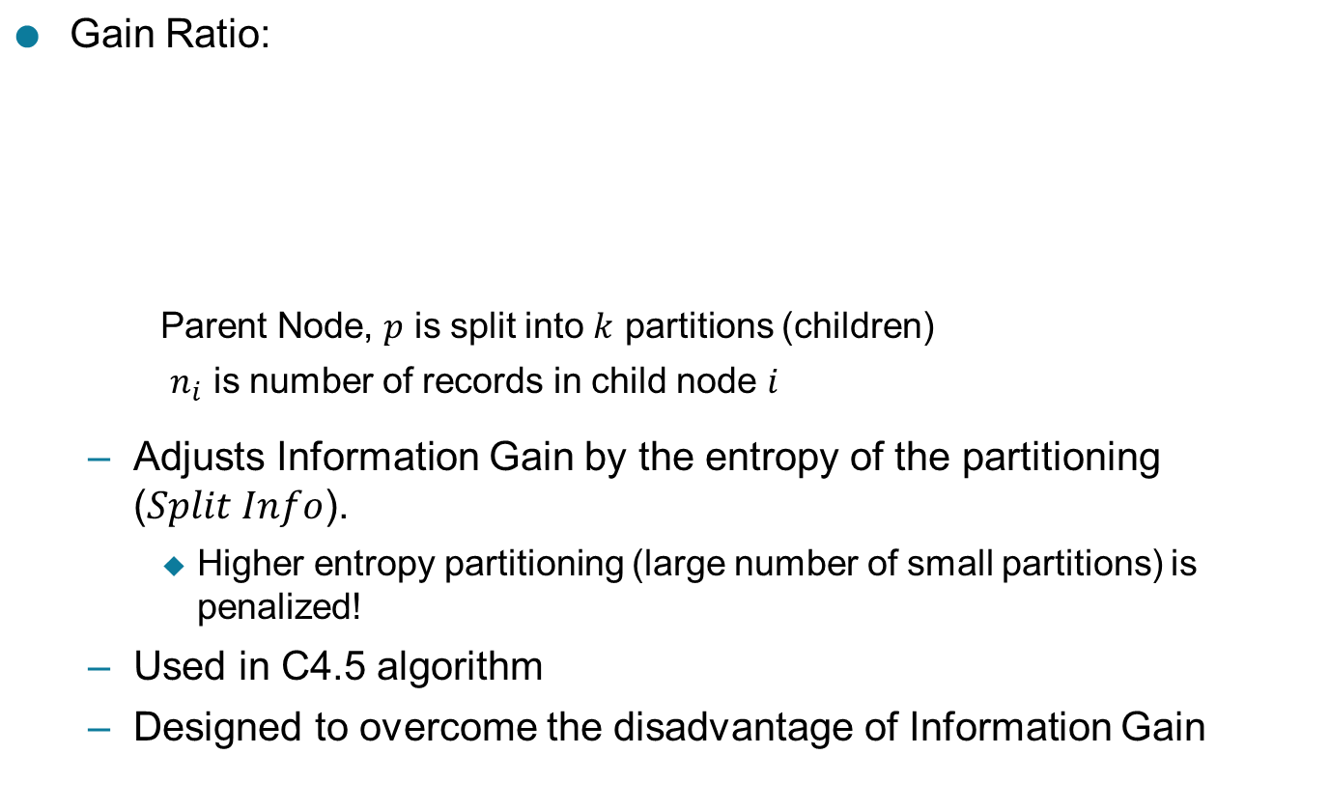
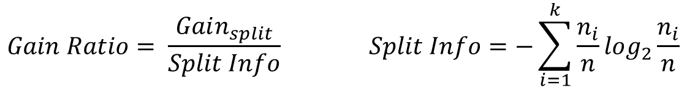
Gain Ratio
T.SudhaRani,Assoc.Professor DWDM

Slide 51
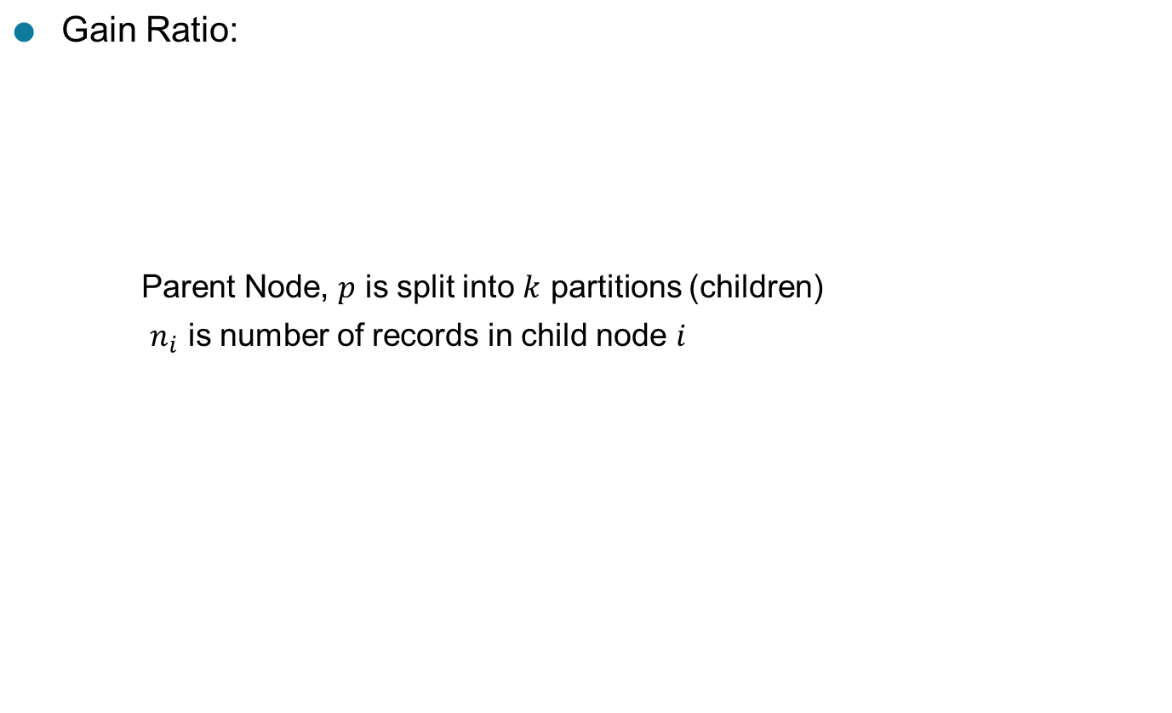
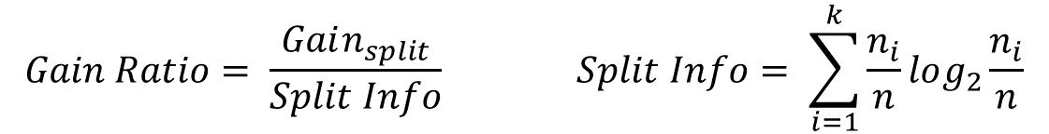
Gain Ratio
SplitINFO = 1.52
SplitINFO = 0.72
SplitINFO = 0.97
T.SudhaRani,Assoc.Professor DWDM

Slide 52
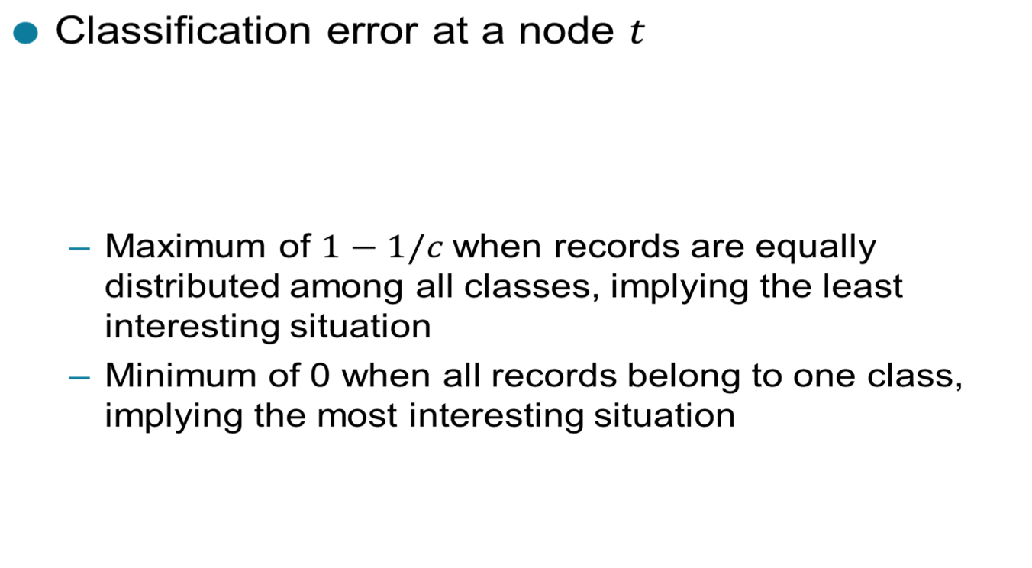

Measure of Impurity: Classification Error
T.SudhaRani,Assoc.Professor DWDM

Slide 53

Computing Error of a Single Node
P(C1) = 0/6 = 0 P(C2) = 6/6 = 1
Error = 1 – max (0, 1) = 1 – 1 = 0
P(C1) = 1/6 P(C2) = 5/6
Error = 1 – max (1/6, 5/6) = 1 – 5/6 = 1/6
P(C1) = 2/6 P(C2) = 4/6
Error = 1 – max (2/6, 4/6) = 1 – 4/6 = 1/3
T.SudhaRani,Assoc.Professor DWDM

Slide 54
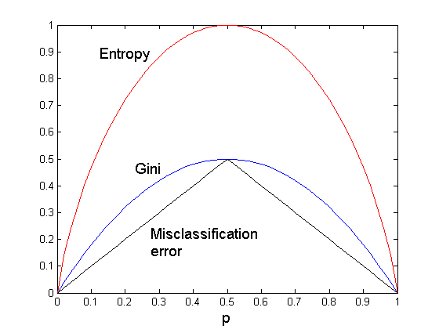
Comparison among Impurity Measures
For a 2-class problem:
T.SudhaRani,Assoc.Professor DWDM

Slide 55

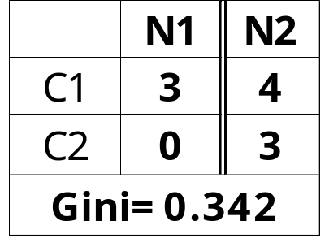
Misclassification Error vs Gini Index
A?
Yes
No
Node N1
Node N2
Gini(N1)
= 1 – (3/3)² – (0/3)²
= 0
Gini(N2)
= 1 – (4/7)² – (3/7)²
= 0.489
Gini(Children)
= 3/10 * 0
+ 7/10 * 0.489
= 0.342
Gini improves but error remains the same!!
T.SudhaRani,Assoc.Professor DWDM

Slide 56
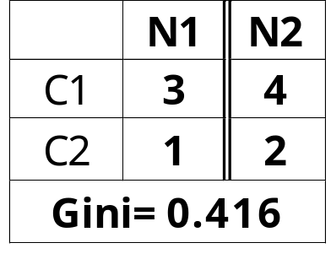
Misclassification Error vs Gini Index
A?
Yes
No
Node N1
Node N2
Misclassification error for all three cases = 0.3 !
T.SudhaRani,Assoc.Professor DWDM

Slide 57
Decision Tree Based Classification
Advantages:
  Relatively inexpensive to construct
  Extremely fast at classifying unknown records
  Easy to interpret for small-sized trees
  Robust to noise (especially when methods to avoid overfitting are employed)
  Can easily handle redundant attributes
  Can easily handle irrelevant attributes (unless the attributes are interacting)
Disadvantages: .
  Due to the greedy nature of splitting criterion, interacting attributes (that can distinguish between classes together but not individually) may be passed over in favor of other attributed that are less discriminating.
  Each decision boundary involves only a single attribute
T.SudhaRani,Assoc.Professor DWDM

Slide 58
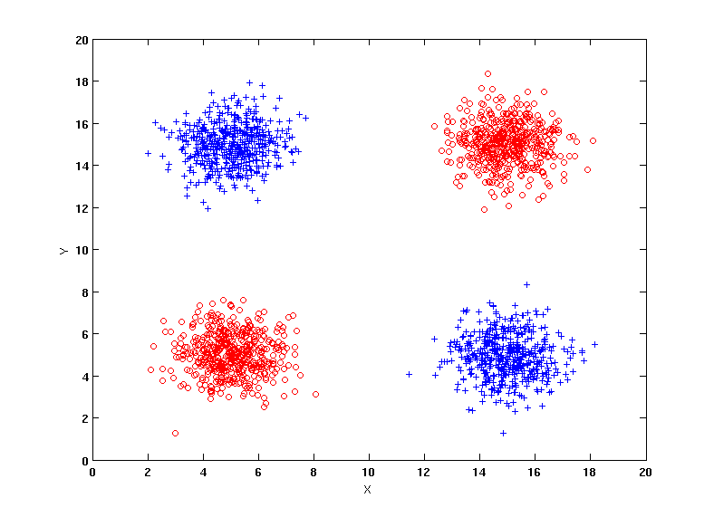
Handling interactions
+ : 1000 instances
o : 1000 instances
Entropy (X) : 0.99
Entropy (Y) : 0.99
Y
X
T.SudhaRani,Assoc.Professor DWDM

Slide 59

Handling interactions
T.SudhaRani,Assoc.Professor DWDM

Slide 60

Handling interactions given irrelevant attributes
+ : 1000 instances
o : 1000 instances
Adding Z as a noisy attribute generated from a uniform distribution
Entropy (X) : 0.99
Entropy (Y) : 0.99
Entropy (Z) : 0.98
Attribute Z will be chosen for splitting!
Y
X
T.SudhaRani,Assoc.Professor DWDM

Slide 61




Limitations of single attribute-based decision boundaries
Both positive (+) and negative (o) classes generated from skewed Gaussians with centers at (8,8) and (12,12) respectively.
T.SudhaRani,Assoc.Professor DWDM

